Slide 1
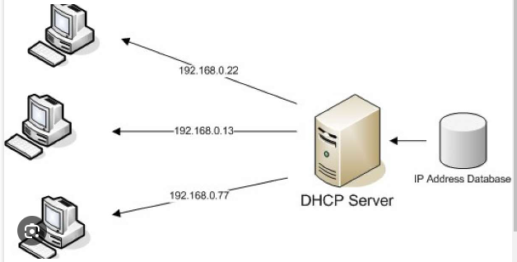
Dynamic Host Configuration Protocol (DHCP)
Compiled by: Hiranya Prasad Bastakoti

Slide 2
contents
DHCP Principle
DHCP Options, Scope, Reservation and Relaying
DHCP Troubleshooting

Slide 3
What is DHCP?
Dynamic Host Configuration Protocol (DHCP) is a network management protocol used to automatically assign IP addresses and other network configuration information to devices on a network
Dynamic Host Configuration Protocol (DHCP) is a client/server protocol that automatically provides an Internet Protocol (IP) host with its IP address and other related configuration information such as the subnet mask and default gateway
The Dynamic Host Configuration Protocol (DHCP) is a protocol employed within Internet Protocol (IP) networks, operating on a client-server model, where DHCP servers manage a pool of IP addresses and lease them out to DHCP-enabled clients when they connect to the network
This process simplifies network administration and eliminates the need for manual configuration, especially in large networks where managing IP addresses individually would be impractical.
DHCP also supports dynamic allocation of IP addresses, meaning that IP addresses are leased to clients for a specific period of time. After the lease expires, the client must renew its lease or request a new IP address. This dynamic allocation allows for efficient use of IP addresses, as addresses that are no longer in use can be reclaimed and assigned to other devices.

Slide 4
Why use DHCP ?
DHCP automates the assignment of unique IP addresses to devices on a TCP/IP-based network, eliminating the need for manual configuration. It simplifies the process of managing IP addresses, especially when devices are added, moved, or removed from the network.
DHCP servers maintain a pool of IP addresses and lease them to DHCP-enabled clients when they connect to the network. The leases are dynamic, allowing unused addresses to be reclaimed and reused.
Network administrators establish DHCP servers that store TCP/IP configuration information in a database. This includes valid IP addresses, reserved addresses, lease durations, and additional DHCP options.
DHCP provides reliable and efficient IP address management, reducing manual configuration errors and simplifying network administration through automation and centralization.
Benefits of DHCP:
Reliable IP address configuration: Minimizes configuration errors and conflicts.
Reduced network administration: Centralized and automated configuration, support for additional TCP/IP settings, efficient handling of IP address changes, and the use of DHCP relay agents to forward messages.

Slide 5
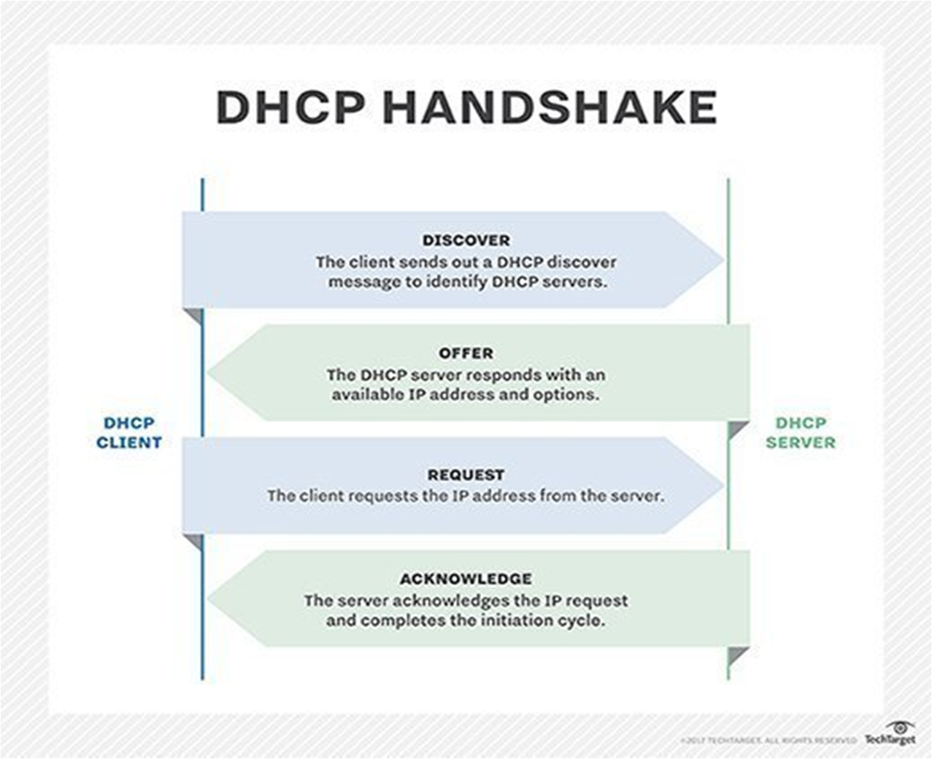
How DHCP Works ?

Slide 6
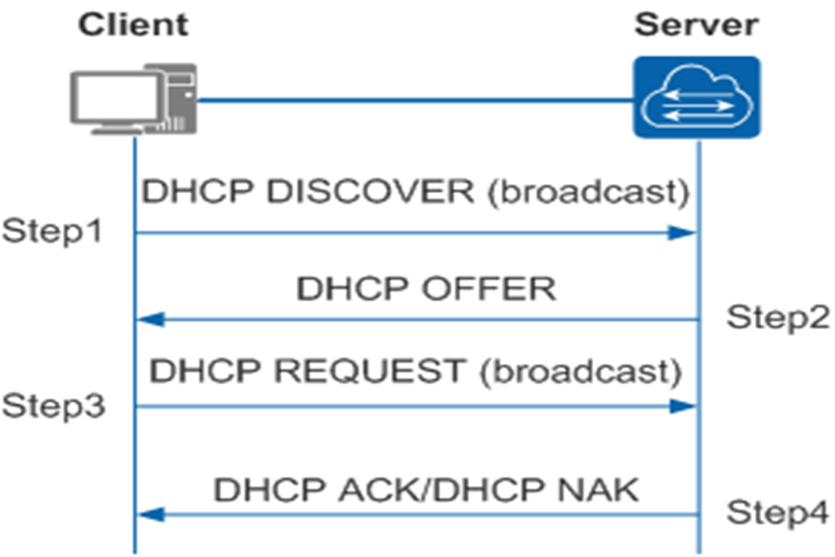
Procedure for a DHCP client to dynamically obtain an IP addres
To obtain a valid dynamic IP address, a DHCP client exchanges different messages with the server at different stages. Generally, the DHCP client and server interact in the following Steps

Slide 7
Step1 :Discovery stage: The DHCP client searches for the DHCP server.
In this stage, the DHCP client sends a DHCP Discover message to search for the DHCP server. The DHCP server address is unknown to the client, so the DHCP client broadcasts the DHCP Discover message. All the DHCP servers send Reply messages after they receive the Discover message. In this way, the DHCP client knows locations of the DHCP servers on the network.
Step 2:Offer stage: The DHCP server offers an IP address to the DHCP client.
The DHCP server receives the DHCP Discover message, selects an IP address from the address pool, and sends a DHCP Offer message to the DHCP client. The Offer message carries information such as the IP address, lease of the IP address, gateway address, and DNS server address.
Step 3 :Request stage: The DHCP client selects an IP address.
If multiple DHCP servers send DHCP Offer messages to the DHCP client, the client receives the first DHCP Offer message. Then the client broadcasts a DHCP Request message including the information about the DHCP server address (Option 54 field).
The client broadcasts a DHCP Request message to notify all the DHCP servers that the client uses the IP address provided by the DHCP server in the Option 54 field and that all the other servers can use the assigned IP addresses.

Slide 8
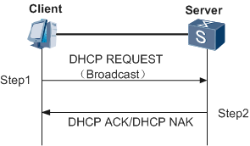
Stage 4:Acknowledgment stage: The DHCP server acknowledges the IP address that is offered.
When the DHCP server receives the DHCP Request message from the DHCP client, the server searches the lease record based on the MAC address in the Request message. If there is the IP address record, the server sends a DHCP ACK message to the client, carrying the IP address and other configurations. After receiving the DHCP ACK message, the DHCP client broadcasts gratuitous ARP packets to detect whether any host is using the IP address assigned by the DHCP server. If no response is received within the specified time, the DHCP client uses the IP address.
If there is no IP address record or the server cannot assign IP addresses, the server sends a DHCP NAK message to notify the DHCP client that the server cannot assign IP addresses. The DHCP client needs to send a new DHCP Discover message to request a new IP address.
After obtaining the IP address, the DHCP client checks the status of the gateway in use before the client goes online. If the gateway address is incorrect or the gateway device fails, the DHCP client requests a new IP address using the four modes for interaction.
The DHCP client uses the assigned IP address.

Slide 9
DHCP Components
DHCP server: DHCP Server is basically a server that holds IP Addresses and other information related to configuration
DHCP client: it is an endpoint that gets the IP address from the DHCP server. Client could be a computer, mobile, laptop
DHCP scope: DHCP scope is the range of IP addresses that the DHCP server will offer Client devices in a network.
Subnet Mask: if the network is divided subnet mask will tell the host about the network in which network it is present.
Lease time: it is the time duration in this duration an IP address is available for a client. After this time duration client will renew the IP address
Gateway address: The gateway address lets the host know where the gateway is to connect to the internet.

Slide 10
DHCP Options
DHCP Options are extra settings that a DHCP server can give to devices asking for an IP address.
DHCP Options are additional IP address settings that a DHCP server passes to DHCP clients.
When a DHCP client requests an IP address from a DHCP server, the server sends the client at least an IP address and a subnet mask value.
Additional information can be sent to clients if you configure various DHCP options
These options can include various configuration settings and parameters that the client can use to customize its network configuration.

Slide 11
Common DHCP Options
Subnet Mask (Option 1): Provides the subnet mask information, allowing devices to understand the network's subnet structure.
Router/Gateway (Option 3): Specifies the IP address of the default gateway or router that devices should use for routing traffic outside their local subnet.
Domain Name Server (DNS) (Option 6): Supplies the IP addresses of DNS servers that devices can use to resolve domain names to IP addresses.
Domain Name (Option 15): Specifies the domain name for devices on the network.
Time Offset (Option 2): Provides the time zone offset in seconds from Coordinated Universal Time (UTC).
NTP Servers (Option 42): Supplies the IP addresses of Network Time Protocol (NTP) servers, allowing devices to synchronize their clocks.
Hostname (Option 12): Communicates the preferred host name for the client.
Broadcast Address (Option 28): Informs devices about the broadcast address for their subnet.
TFTP Server Name (Option 66): Specifies the hostname or IP address of a TFTP server. Often used in VoIP deployments for firmware updates.
Bootfile Name (Option 67): Specifies the name of the boot file that devices should load from a TFTP server.

Slide 12
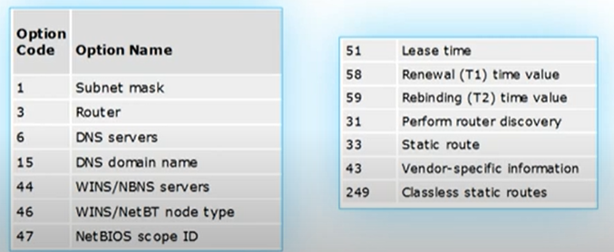
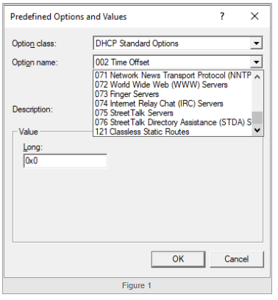
Other options

Slide 13
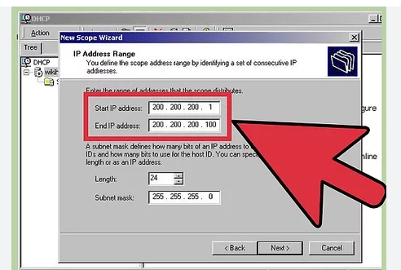
DHCP Scope
A DHCP (Dynamic Host Configuration Protocol) scope refers to a range of IP addresses that a DHCP server is configured to lease to client devices on a network.
This allows devices to automatically obtain IP addresses, subnet masks, gateways, and other network configuration settings without manual intervention
DHCP scopes are essential for managing IP address allocation in larger networks, as they help prevent IP address conflicts and make it easier to maintain a consistent network configuration. Different scopes can be set up for different network segments, departments, or purposes

Slide 14
DHCP Scope includes :
IP Address Range: This is a range of IP addresses that the DHCP server can assign to client devices. For example, a scope might have a range of addresses from 192.168.1.100 to 192.168.1.200.
Subnet Mask: This defines the network's subnet and helps devices determine which part of the IP address is the network identifier and which part is the host identifier.
Gateway (Router) IP: The IP address of the default gateway that devices should use to access other networks or the internet.
DNS Server IPs: The IP addresses of Domain Name System (DNS) servers that devices should use for translating domain names into IP addresses.
Lease Duration: The amount of time for which a client device is allowed to use the assigned IP address before it needs to renew the lease.
Additional Configuration Options: DHCP scopes can also include other configuration settings like WINS (Windows Internet Name Service) server addresses and domain name settings

Slide 15
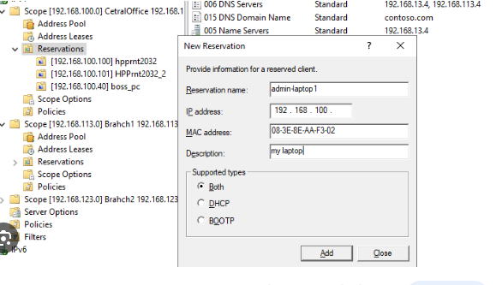
DHCP Reservation

Slide 16
Contd..
A DHCP reservation is a way to assign a fixed IP address to a specific device within a DHCP scope.
A reservation is based on the MAC address of the device, which is a unique identifier for its network interface.
A DHCP server can have multiple reservations for different devices within a scope.
DHCP reservation is a feature that allows the DHCP server to reserve a specific IP address for a particular device on the network.
This ensures that the device always receives the same IP address when it requests network configuration, providing a consistent and predictable address for that device.

Slide 17
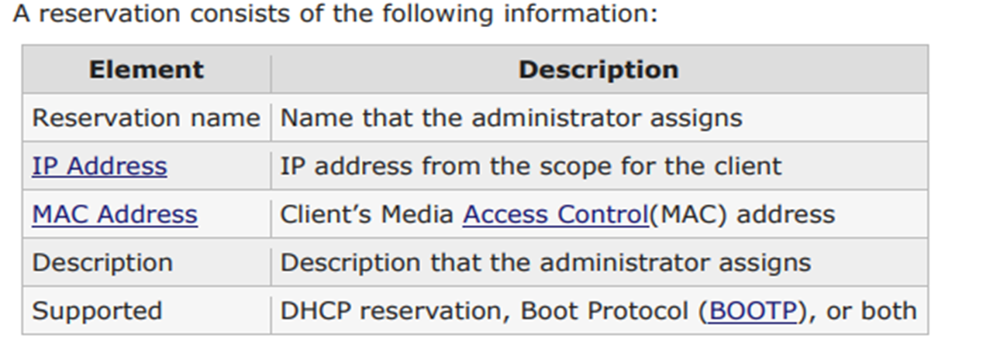

Slide 18
Advantages
Consistent IP Addressing: Devices always receive the same IP address, making it easier to manage and troubleshoot network connections.
Centralized Management: Administrators can manage IP address assignments from a central DHCP server rather than configuring static IP addresses on individual devices.
Scalability: DHCP reservations are scalable, allowing administrators to manage IP address assignments for a large number of devices efficiently.
Flexibility: Administrators can easily modify or remove reservations as needed, providing flexibility in network management.

Slide 19
DHCP Relay
DHCP Relay provides a way for DHCP clients to communicate with DHCP servers when none are available on its local subnet.
A Relay Agent uses IP routing to forward discover messages to a provisioned DHCP server. The relay agent then relays the DHCP offer back to the client network
A DHCP relay agent is a host or router that forwards DHCP packets between clients and servers.
The DHCP relay agent is any TCP/IP host which is used to forward requests and replies between the DHCP server and client when the server is present on a different network.
Relay agents receive DHCP messages and then generate a new DHCP message to send out on another INTERFACE
DHCP relay agents are commonly used in large enterprise networks where the DHCP server is located on a different network segment than the client devices.
The DHCP relay agent listens for DHCP broadcast messages from the client devices and then forwards those messages to the DHCP server, encapsulating them in a unicast packet.
The DHCP relay agent may be configured with one or more IP addresses of DHCP servers that it can forward requests to when intercepting DHCP discover messages from clients.

Slide 20
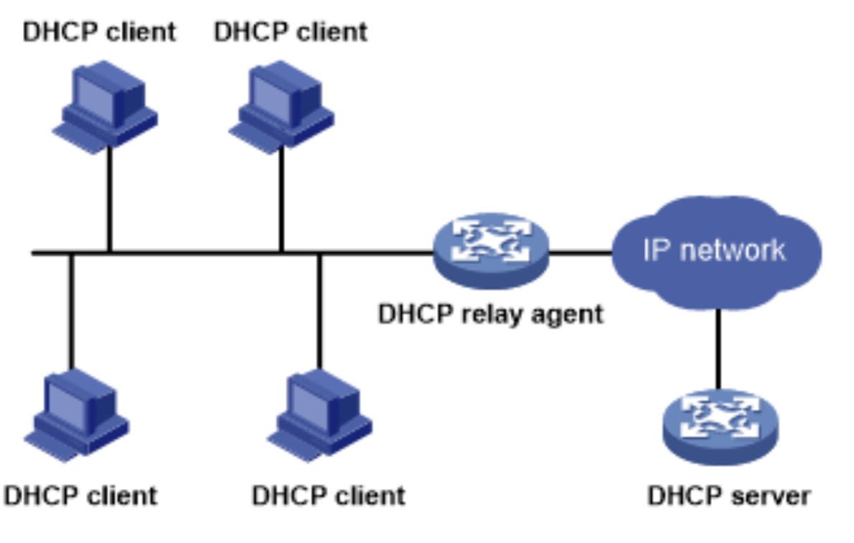
DHCP Relay

Slide 21
Troubleshooting In DHCP
There are a number of reasons that can cause DHCP problems, for example;
Errors in configuration.
Software defects in operating systems
Corrupt or deleted NIC drivers
DHCP/BOOTP relay agents.

Slide 22

Troubleshooting steps
Check Physical Connection
Check for IP address conflict
Test connectivity with other clients using static IP addresses
Confirm switch port configuration
Verify the source of the client’s address
Use Nmap, tcpdump, and Wireshark to discover why your enterprise switch and clients aren't communicating IP configurations correctly.

Slide 23
DHCP Installation steps in Centos
Install
Install dhcp on CentOS
Configure
Configure CentOS dhcp Server
Start and enable
Start and enable the dhcpd service.

Slide 24
Step 1: Install DHCP Server Package:
Use the yum package manager to install the DHCP server package
sudo yum install dhcp
Step 2: Configure DHCP Server
Edit the DHCP configuration file /etc/dhcp/dhcpd.conf with your preferred text editor.
sudo nano /etc/dhcp/dhcpd.conf

